Slide 1
Boruvka’s algorithm

Slide 2
Algorithm definition
1) Input is a connected, weighted and directed graph.
2) Initialize all vertices as individual components (or sets).
3) Initialize MST as empty.
4) While there are more than one components, do following
for each component.
a) Find the closest weight edge that connects this
component to any other component.
b) Add this closest edge to MST if not already added.
5) Return MST.

Slide 3
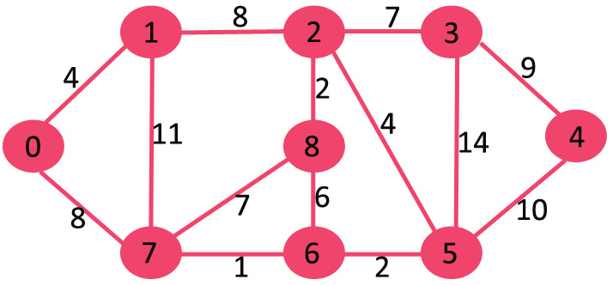
Initial graph

Slide 4
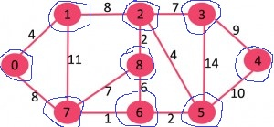
Step 2, 3
Initially MST is empty. Every vertex is singe component as highlighted in blue color in below diagram

Slide 5
Edges
Component Cheapest Edge that connects
it to some other component
{0} 0-1
{1} 0-1
{2} 2-8
{3} 2-3
{4} 3-4
{5} 5-6
{6} 6-7
{7} 6-7
{8} 2-8

Slide 6
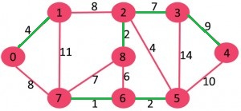
Step 4
Component Cheapest Edge that connects
it to some other component
{0} 0-1
{1} 0-1
{2} 2-8
{3} 2-3
{4} 3-4
{5} 5-6
{6} 6-7
{7} 6-7
{8} 2-8

Slide 7
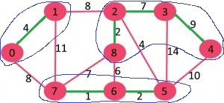
Step 2,3 Iteration 2

Slide 8
Edges – iteration 2
Component Cheapest Edge that connects
it to some other component
{0,1} 1-2 (or 0-7)
{2,3,4,8} 2-5
{5,6,7} 2-5

Slide 9
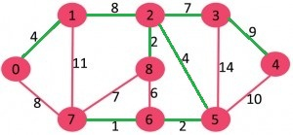
Edges – iteration 2
Component Cheapest Edge that connects
it to some other component
{0,1} 1-2 (or 0-7)
{2,3,4,8} 2-5
{5,6,7} 2-5

